Slide 1
Split Dollar Loans with Permanent Life Insurance
For Business Owners
The companies of National Life Group ® and their representatives do not offer tax or legal advice. For advice concerning your own situation, please consult with your appropriate professional advisor.
Notes:
Understanding the opportunities for using split dollar loans with permanent life insurance.

Slide 2
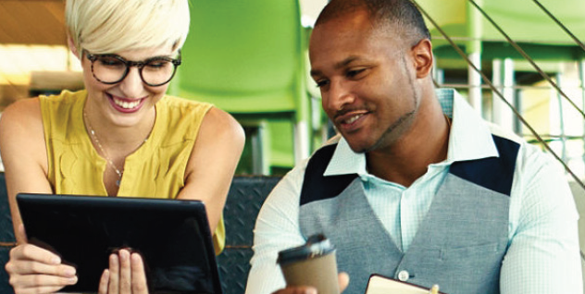
Mike and Annie are 50/50 owners
Successful business with cash flow for personal benefits
Notes:
What to say: “Let’s talk about our sample business owners. Mike and Annie are 50/50 owners. Their business is successful and we know that their cash flow is sufficient to provide themselves with additional personal benefits. As we’ve discussed, it’s great that you and your business are in a similar situation. Just to make sure we’re on the same page, you told me that you’re currently _____(FILL IN THE BLANKS)______.”

Slide 3
Mike and Annie Want a Program That…
Allows flexible participation and contributions
Has a small impact on the business balance sheet
Minimizes their personal out of pocket and tax cost
Provides funds in case of death or illness
Provides potential to accumulate funds for retirement
Notes:
What to say: Just read the slide as it builds

Slide 4
Why?
Allows flexible participation and contributions
Has a small impact on the business balance sheet
Minimizes their personal out of pocket and tax cost
Provides funds in case of death or illness
Provides potential to accumulate funds for retirement
Allows flexible participation and contributions
Choose who will participate
No government restrictions on contributions
Notes:
What to say: “Let’s dig a little deeper into these ideas. I call it understanding the Why? First, our business owners want a plan that provides flexibility in both participation and contributions. They want to be able to provide benefits to themselves and not necessarily their other key people or the so called rank and file employees in their business. The flexibility to select the individuals to benefit from a special program is important to preserve and award excellent work (when the benefit is for an employee) and to reward themselves as the owners of the business. They also recognize that financial situations can change. Cash flow available for a special benefit may vary each year. They don’t want to be locked into set amounts each year.
“The good news is that there is a category of benefits – called non qualified plans – that allows for this type of flexibility.
“Is this a concern that you have as we build out a plan for you?”

Slide 5
Why?
Allows flexible participation and contributions
Has a small impact on the business balance sheet
Minimizes their personal out of pocket and tax cost
Provides funds in case of death or illness
Provides potential to accumulate funds for retirement
Has a small impact on the business balance sheet
Maintain balance sheet stability
Control timing of funds moving on or off the balance sheet
Notes:
What to say: “For our sample client – they feel that any program they put in place needs to have a minimal impact on their balance sheet. They also want to be able to control the timing of funds moving on or off the balance sheet.”

Slide 6
Why?
Allows flexible participation and contributions
Has a small impact on the business balance sheet
Minimizes their personal out of pocket and tax cost
Provides funds in case of death or illness
Provides potential to accumulate funds for retirement
Minimizes their personal out of pocket and tax cost
Tax efficient programs for the contribution, accumulation and distribution phases of the plan
Notes:
What to say: “As we’ve been talking about, in the non qualified plan world there are a number of different tax outcomes possible. For the client’s we’re talking about today, they have a strong preference to minimize current tax costs and personal out of pocket cash flow. With that, they also don’t want to sacrifice potential tax efficiencies during the accumulation and distribution phases of the plan. That simply means that they want to see if there is a plan that may provide tax benefits all the way thru.
“The good news is that depending upon the specifics of each situation, non qualified plans can be molded to be very tax efficient in all elements of the program.”

Slide 7
Why?
Allows flexible participation and contributions
Has a small impact on the business balance sheet
Minimizes their personal out of pocket and tax cost
Provides funds in case of death or illness
Provides potential to accumulate funds for retirement
Provides funds in case of death or illness
Die Too Soon, Become Ill
Notes:
What to say: “Why is important to our client’s to have a plan that may provide access to them or their families in the case of death or illness? For instance, it’s not hard to imagine what might happen to you and your family if you became too ill to work. Walk it thru in your mind. Put yourself in the situation. Think about what happens, not only to you and your family but to your business and to your co owners.
“Do the same walk thru thinking about what things look like financially if you had died yesterday. This isn’t always an easy exercise but it is vital to you and your family.’
[At this point you may also want to share some personal stories about the “die too soon, become ill” scenarios.]

Slide 8
Why?
Allows flexible participation and contributions
Has a small impact on the business balance sheet
Minimizes their personal out of pocket and tax cost
Provides funds in case of death or illness
Provides potential to accumulate funds for retirement
Provides potential to accumulate funds for retirement
Potential for Tax Free Income
Live Too Long
Notes:
What to say: “So we’ve had a quick exercise thinking about one side of the benefit spectrum (how to take care of you and your family in the case you die too soon or become ill). On the happier side, our clients’ in this example are laser focused on the accumulation of funds for their retirement. In addition to wanting to accumulate sufficient funds for a comfortable retirement, they also want to understand whether tax free income is available. They are also concerned about out living their income sources.
“Does this feel familiar to you too?”

Slide 9

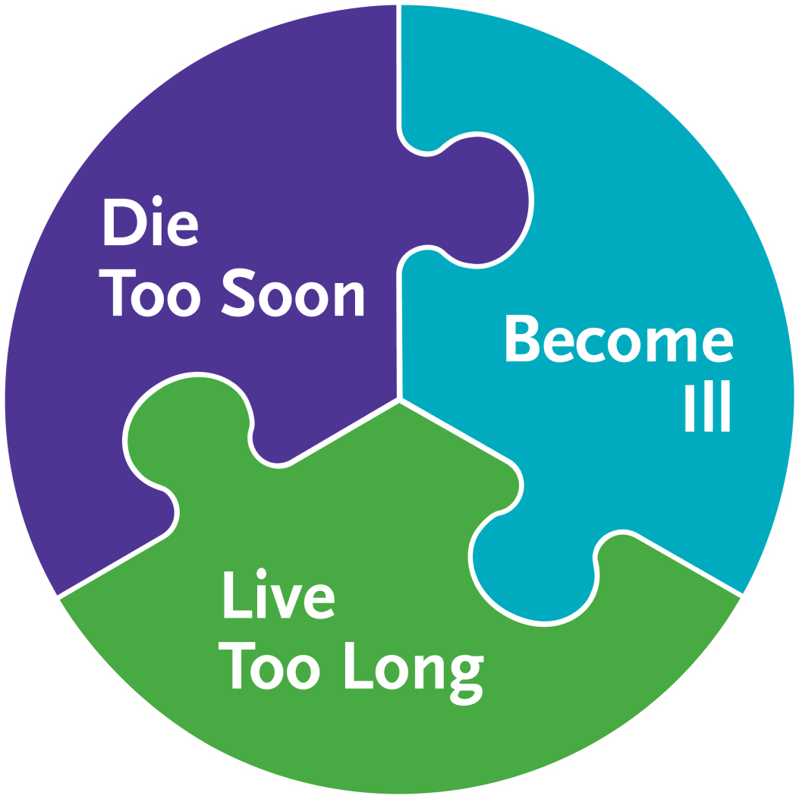
Split Dollar With Permanent Life
Insurance
The only program that can deliver on all of Mike and Annie’s wishes
IRS approved program
Use your C Corporation Tax Rate to leverage benefits
Business A/T
Cash Flow
Permanent Life Insurance
Wants the Benefits
Notes:
What to say: “With the answers that you’ve given on the elements that are key to you, a concept called split dollar with permanent life insurance may be the program best suited to you. This is an IRS approved program, with the requirements clearly set out by the Treasury department in certain IRS regulations.
“The concept let’s you use your low C Corporation tax rate (which is now at 21% for federal tax purposes) to pay for the premium on your personally owned life insurance. Basically, you use your business after tax cash flow to pay for the premium on the permanent life insurance and the insurance may provided you with the benefits you want.

Slide 10
Benefits of Using Permanent Life Insurance
1
Income tax free death benefit1
2
Potential for retirement income through tax free loans
and withdrawals2
3
Optional Accelerated benefits riders available that allow you to
Access the death benefit in the event of a qualifying terminal,
Chronic or critical illness3
4
Many variations possible
IRC Section 101(a)(1). There are some exceptions to this rule. Please consult a qualified tax professional for advice concerning your individual situation.
The ability of a life insurance contract to accumulate sufficient cash value to help meet accumulation goals will be dependent upon the amount of extra premium paid into the policy, and the performance of the policy, and is not guaranteed. Policy loans and withdrawals reduce the policy’s cash value and death benefit and may result in a taxable event. Withdrawals up to the basis paid into the contract and loans thereafter will not create an immediate taxable event, but substantial tax ramifications could result upon contract lapse or surrender. Surrender charges may reduce the policy’s cash value in early years.
Payment of Accelerated Benefits will reduce the Cash Value and Death Benefit otherwise payable under the policy. Receipt of Accelerated Benefits may be a taxable event and may affect your eligibility for public assistance programs. Please consult your personal tax advisor to determine the tax status of any benefits paid under this rider and with social service agencies concerning how receipt of such a payment will affect you. Riders are supplemental benefits that can be added to a life insurance policy and are not suitable unless you also have a need for life insurance. Riders are optional, may require additional premium and may not be available in all states or on all products. This is not a solicitation of any specific insurance policy.
Notes:
This slide lets you spell out in more detail what the potential benefits of permanent life insurance may be for the client.

Slide 11

How Split Dollar Works
Pays
Interest
Loans Premium
BUSINESS
Collateral Assignment
And Principal Repayment
OWNER
Notes:
What to say:
Here you see a flow chart representing the flow of funds and benefits in a loan split dollar.
The policy will be owned by the executive.
The business will pay the premium on the policy and will treat that payment as a loan to the executive.
To protect the business’ interest in the arrangement, the executive will collaterally assign the policy to the business.
The executive will pay interest on the loan each year.

Slide 12
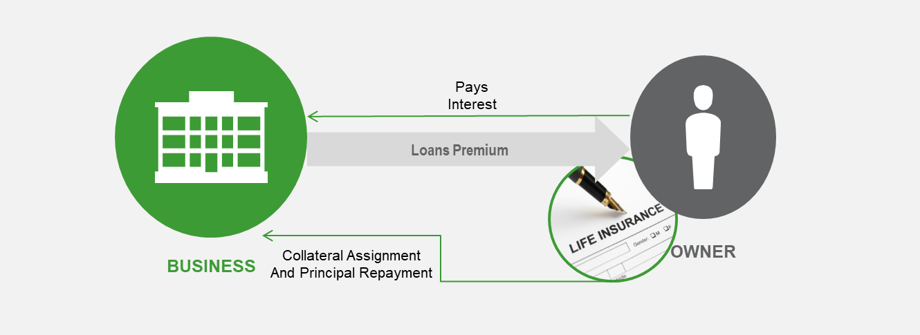
What You Want to Know About Interest
1
Rate is set based on the type of loan
2
May be paid annually or accrued
3
Interest may be forgiven resulting in taxable income
Notes:
What to Say
“There are a couple of technical points that I like to point out about interest on split dollar loans. First, the rate is set based on the type of loan. As we move forward, I’ll be happy to go thru these concepts with you. What is the minimum interest required under the tax rules? The minimum interest rate is set by the IRS and will be based on the terms of the loan. The minimum interest rate required will be based on the rate in effect the month the split dollar loan is made.
Next, the interest may be paid annually, out of pocket, by the policy owner. Or, the interest may be accrued and added to the loan principal. It will be paid when the split dollar plan is ended.
If the policy owner does not pay the interest, or the interest is lower than the minimum required for the loan under the tax rules, then the amount not paid will be treated as taxable income to the executive. “

Slide 13

SD Loan on Your Business and Personal Balance Sheets
21%
37%
Business
Personal
Asset
Liability
Asset
Liability
Premium Paid by Loan
Cash
A/T Interest
Tax on Interest
Interest on Loan
Receivable
Loan
Repayment
Notes:
We find it helpful to position the cash flow of a split dollar loan scenario on scaled down balance sheets. We have, on the left side a business balance sheet. On the left side a personal balance sheet. We’ll start with the client acquiring a personally owned permanent life insurance policy. When considering how to pay for the premium, we note that the business is in a 21% tax bracket vs. the personal 37% rates. Using split dollar, we can use the 21% tax bracket to pay for the premium on the policy. The business pays the premium and treats that payment as a loan. The policy owner will pay interest to the business – that is treated as taxable income to the business. The after tax interest is a business asset. In addition, at some time in the future, let’s say at death or retirement, the policy owner will repay the total loan to the business. The death benefit would be the source of the repayment in the event of the death of one of the owners. If the policy has sufficient cash value, it could be used to repay the loan using either policy loans or withdrawals at the owner’s retirement or other separation of service. At that point, the loan repayment retires the debt and the receivable becomes cash.

Slide 14
After the Loan Repayment
21%
37%
Business
Personal
Asset
Liability
Asset
Liability
Cash
May be distributed
Notes:
What to say: When the split dollar plan terminates the business will, generally, have all that cash on its balance sheet. There are a couple of scenarios on how that cash can be put to use. It might be distributed to you either as compensation or a dividend. Or, the funds may be used as part of a buy sells funding. Or, the funds may be used to help pay for other business expenses, including other benefit plans for other employees. The tax result will wholly depend on how you characterize the distribution.

Slide 15
Is this Right For You?
Next Steps.
Notes:
Let’s consider our next steps. The key is to look at what is important to you and whether split dollar or any of the other executive benefits programs are appropriate to your situation.

