Slide 1
How to Choose an Executive Benefit Program
No bank or credit union guarantee | Not a deposit | Not FDIC/NCUA insured | May lose value | Not insured by any federal or state government agency
This information is not intended as tax or legal advice. For advice concerning your own situation,
please consult with your appropriate professional advisor.

Slide 2
YOUR BUSINESS TIMELINE
YOUR BUSINESS TIMELINE
CURRENT BENEFIT PLANS
DEFERRED BENEFIT PLANS

  Executive Bonus

  Salary Continuation

  Split Dollar – Loan Regime

  Deferred Compensation

  Split Dollar – Economic Benefit Regime
Notes:
Every business has a life cycle and we measure that life cycle on what we call the business time line. Along that business timeline, there are events that we know will occur. But while the event itself is predictable, it’s often unpredictable as to when it will occur.
One event that we can predict on a businesses timeline is the desire to provide a key person (or persons) with enhanced compensation or targeted benefits that are designed to reward and retain that employee. At some point on the timeline you may also want to provide benefits that help you attract special new talent. Another predictable event on your business timeline is the desire to use business funds to create a personal benefit for yourself and other owners.
The cost and outlays of a plan will depend on some of the decisions you make now as well as the economic realities at the time the benefit is paid.
These types of benefit programs appear on a business time line in one of two ways.
Current benefit plans – where the business is making a current contribution and the participant is receiving a current benefit. The participant will either incur a current tax or other cost outlay (such as interest on a split dollar loan).
Deferred benefit plans – where the business is making a contractual promise to pay a benefit some time in the future. The participant generally does not receive a current economic value and so does not incur any current taxes or other cost outlays. The participant will include the benefits in income when actually received and the business will receive a tax deduction for those payments at that time.
There’s no one right or wrong answer for anyone. At times, using more than one program may create the right benefit to cost balance.

Slide 3
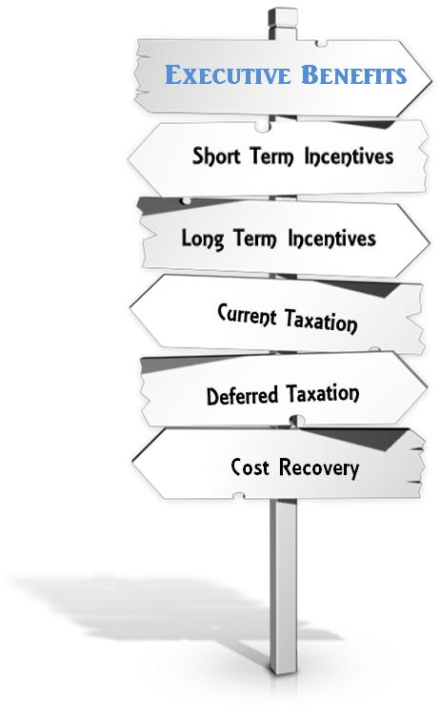
Elements of Executive Benefits
Notes:
Benefits that are designed to reward the key people in your business (including yourself) come in many shapes and sizes.
The term “executive benefits” is an umbrella term for non qualified arrangements that are made between the business and certain executives.
These plans are not provided to all the employees in the business. The government tells us that these types of non-qualified arrangements may only be provided to the highly compensated or select group of management.
Interestingly, the benefits do not have to be offered to all of the key executives. You may pick and choose who will participate. And, the benefits may be different from participant to participant.
Depending on whether you are looking for short or long term incentives, want to provide benefits that result in deferred taxation, whether you want cost recovery to the business – the exact type of non-qualified benefit program that is most appropriate for you will vary depending upon your answers to these questions.

Slide 4
WHAT ARE YOU LOOKING FOR?
BUSINESS CASH FLOW AND TAXES | BUSINESS BENEFITS | PARTICIPANT CASH FLOW AND TAXES | PARTICIPANT BENEFITS
Current Tax Deduction | Tax Deferred Accumulations | Current Income Tax | Income Tax Free Death Benefit
Future Tax Deduction | Select Only Key Employees | Future Income Tax | Potential for Personal Accumulation
Cost Recovery | Liquidity1 | Tax Deferred Accumulations | Liquidity/ Credit Source
Current Cash Outlay Required | Flexible Contributions² | Tax Advantaged Distributions¹ | Resource for Illness/Injury3
Notes:
This chart shows different issues that non qualified arrangements might address. Depending on which issue is most important to your client this chart will help guide you to an arrangement that may be most appropriate for your client. The two columns on the left address business issues and the two on right address personal issues. We’ll see how the issues “light up” in the next set of slides.
Let’s consider each column. The left hand column looks at business cash flow and tax preferences.
The first three boxes consider whether current or future tax deductions are vital to the business and whether the program should provide for cost recovery to the business. The last box to consider is whether the business is comfortable with having to make a current cash outlay to fund the program.
The column labeled business benefits looks at other issues. If the business is putting funds away, should the funds be placed into a tax deferred accumulation vehicle, such as permanent life insurance? Is the program going to be provided only to a select group of employees – essentially the key people in the business. Does this business need to maintain a certain level of liquidity? Should the program have flexible contribution requirements?
On the personal side – under personal cash flow and taxes – these are questions addressed to the participant. Is there a preference for current income tax or future income tax costs? Should the program provide for tax deferred accumulations. Tax advantaged distributions assume the program allows for the potential to receive distributions without incurring income taxes.
In the last column you see some key personal benefits. Should the program include income tax free death benefit payments to the participant’s named beneficiary. Should the program provide the opportunity for personal accumulations? Should the program be a potential source of personal liquidity and/or a credit source. Finally, should the program provide a resource for financial assistance in the event of the participant’s illness or injury?

Slide 5
BUSINESS CASH FLOW AND TAXES | BUSINESS BENEFITS | PARTICIPANT CASH FLOW AND TAXES | PARTICIPANT BENEFITS
Current Tax Deduction | Tax Deferred Accumulations | Current Income Tax | Income Tax Free Death Benefit
Future Tax Deduction | Select Only Key Employees | Future Income Tax | Potential for Personal Accumulation
Cost Recovery | Liquidity1 | Tax Deferred Accumulations | Liquidity/ Credit Source
Current Cash Outlay Required | Flexible Contributions² | Tax Advantaged Distributions¹ | Resource for Illness/Injury3

  Review the Grid and Highlight Your Key Concerns

  Compare Your Answers to the following Grids to See Which is the Closest Match
Notes:
What to do now?

Slide 6
EXECUTIVE BONUS TO PERMANENT LIFE INSURANCE
BUSINESS CASH FLOW AND TAXES | BUSINESS BENEFITS | PARTICIPANT CASH FLOW AND TAXES | PARTICIPANT BENEFITS
Current Tax Deduction | Tax Deferred Accumulations | Current Income Tax | Income Tax Free Death Benefit
Future Tax Deduction | Select Only Key Employees | Future Income Tax | Potential for Personal Accumulation
Cost Recover | Liquidity¹ | Tax Deferred Accumulations | Liquidity/ Credit Source
Current Cash Outlay Required | Flexible Contributions² | Tax Advantaged Distributions¹ | Resource for Illness/Injury3
Notes:
Here we see the key profile issues for an executive bonus arrangement which is used to pay for life insurance premiums..

Slide 7
SALARY CONTINUATION
BUSINESS CASH FLOW AND TAXES | BUSINESS BENEFITS | PERSONAL CASH FLOW AND TAXES | PERSONAL BENEFITS
Current Tax Deduction | Tax Deferred Accumulations | Current Income Tax | Income Tax Free Death Benefit
Future Tax Deduction | Select Only Key Employees | Future Income Tax | Potential for Personal Accumulation
Cost Recovery | Liquidity¹ | Tax Deferred Accumulations | Liquidity/ Credit Source
Current Cash Outlay | Flexible Contributions² | Tax Advantaged Distributions¹ | Resource for Illness/Injury 3
Notes:
Here we see the key profile issues for a salary continuation arrangement.

Slide 8
SPLIT DOLLAR ECONOMIC BENEFIT
BUSINESS CASH FLOW AND TAXES | BUSINESS BENEFITS | PARTICIPANT CASH FLOW AND TAXES | PARTICIPANT BENEFITS
Current Tax Deduction | Tax Deferred Accumulations | Current Income Tax | Income Tax Free Death Benefit
Future Tax Deduction | Select Only Key Employees | Future Income Tax | Potential for Personal Accumulation
Cost Recovery | Liquidity1 | Tax Deferred Accumulations | Liquidity/ Credit Source
Current Cash Outlay Required | Flexible Contributions² | Tax Advantaged Distributions¹ | Resource for Illness/Injury 3
Notes:
Here we see the key profile issues for a split dollar economic benefit arrangement.

Slide 9
SPLIT DOLLAR LOAN
BUSINESS CASH FLOW AND TAXES | BUSINESS BENEFITS | PARTICIPANT CASH FLOW AND TAXES | PARTICIPANT BENEFITS
Current Tax Deduction | Tax Deferred Accumulations | Current Income Tax | Income Tax Free Death Benefit
Future Tax Deduction | Select Only Key Employees | Future Income Tax | Potential for Personal Accumulation
Cost Recovery | Liquidity1 | Tax Deferred Accumulations | Liquidity/ Credit Source
Current Cash Outlay Required | Flexible Contributions² | Tax Advantaged Distributions¹ | Resource for Illness/Injury 3
Notes:
Here we see the key profile issues for a split dollar loan arrangement.

Slide 10
FOOTNOTES
Policy loans and withdrawals reduce the policy’s cash value and death benefit and may result in taxable event. Withdrawals up to the basis paid into the contract and loans thereafter will not create an immediate taxable event, but substantial tax ramifications could result upon contract lapse or surrender. Surrender changes may reduce the policy’s cash value in early years.
It is possible that coverage will expire when either no premiums are paid following the initial premium, or subsequent premiums are insufficient to continue coverage.
May be provided by optional riders that provide benefits in the event of a qualifying critical, chronic or terminal illness, critical injury, or disability. Riders are supplemental benefits that can be added to a life insurance policy and are not suitable unless you also have a need for life insurance. Riders are optional, may require additional premium and may not be available in all states or on all products.

Slide 11
Next Steps

  Consider Your Business Situation

  Consider Your Personal Situation

  Identify the Key Issues

  Review and Discuss With Your Planning Team

